Slide 1
Red Cross Case: Chatbot

Slide 2




vulnerable populations facing challenges when navigating Red Cross FAQ pages

Slide 3
Challenges
Irrelevant
Irrelevant information is sometimes showned
Outdated
Some informations can be outdated and needed to be rechecked
Innacurate
Innacurate information can be showned
Incomplete
Information is sometimes scattered

Slide 4


Project Goal
Design a reliable chatbot to help vulnerable populations access accurate information and resources

Slide 5
Data Preprocessing
Retrieve information about Categories, sub-Categories and Offers about RedCross FAQ pages
Transform into a JSON file

Slide 6

Chain of Thought
"Let's think step by step"
Model used: DeepSeek-R1
based on CoT, providing the intermediate reasoning steps in response

Slide 7
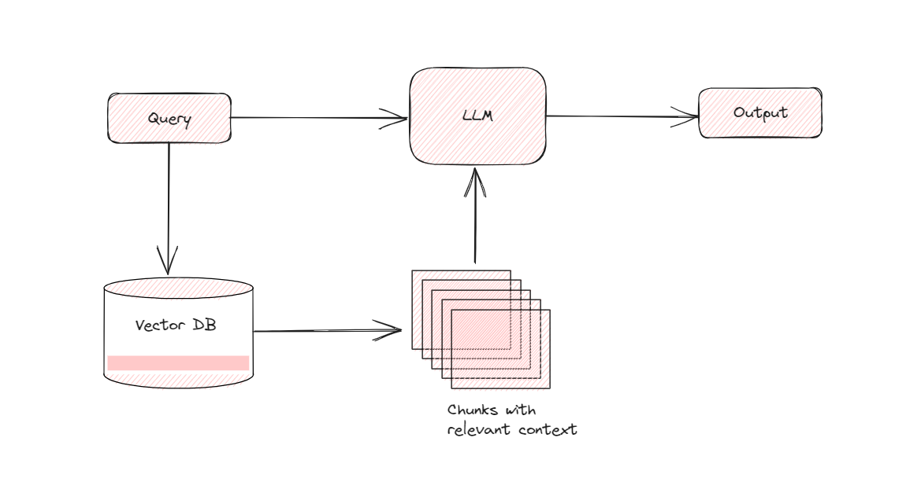
RAG
How RAG works:
Transform documents to a vectorized Database
Context is given to LLM given information in the database
Output is generated
Benefits:
Reliable knowledge base
Scalable
Source citation

Slide 8
Prompt Chaining
first extract relevant quotes for a question
generate an answer using those quotes and the original document
Benefits:
Enhances context understanding, transparency, controllability, and reliability of LLM applications.
Simplifies debugging and allows targeted performance improvements at each stage.
Particularly useful for:
Building conversational assistants.
Enhancing personalization and user experience in applications.

Slide 9

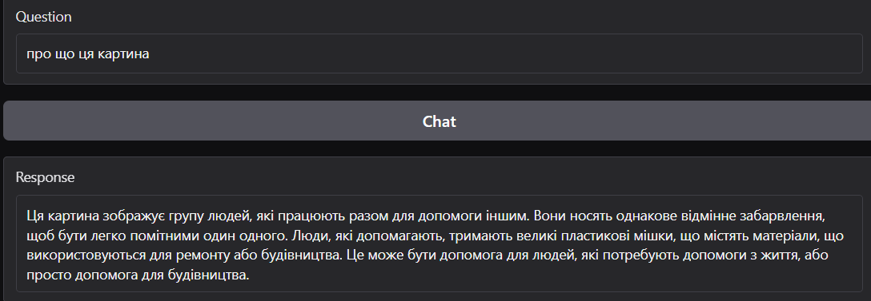
Multimodal model
Enable Image Input
users can ask questions about the image in their native language
Model: Deepseek Janus-Pro
Question: What's the image about? (Ukraine)
This painting depicts a group of people working together to help others. They wear the same distinctive color to be easily visible from each other. Helpers hold large plastic bags containing materials used for repairs or construction. It can be help for people who need help with life, or just help for construction.

Slide 10
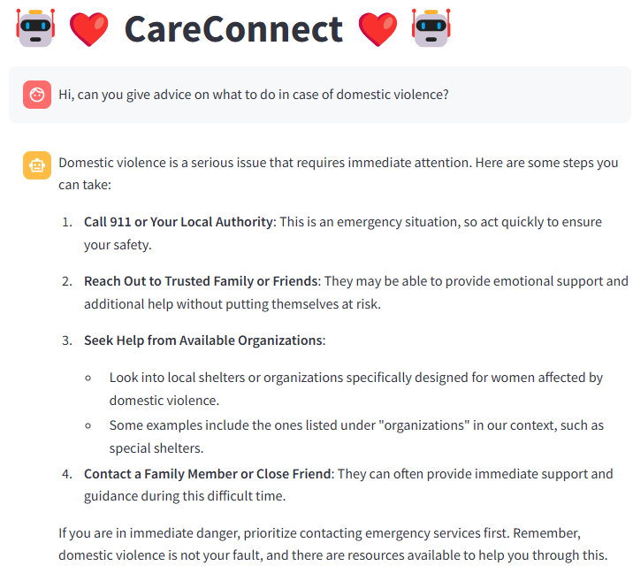

Demo: CareConnect
Example of Prompt Chaining

Slide 11
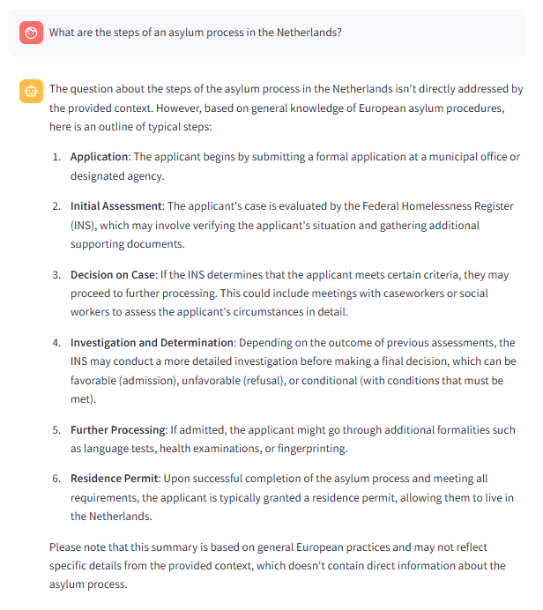
Demo: some other important prompts

Slide 12
Conclusions
Improved relevance and accuracy by CoT, RAG, Prompt Chaining
Provided information with sources, their last updated dates and summary by prompt engineering
Offered a more interactive conversational experience
Enable image input by Multimodal model Deepseek Janus
Future Work
Integrate the multimodal model into the chatbot, offer recommendation links related to the image

